Slide 1
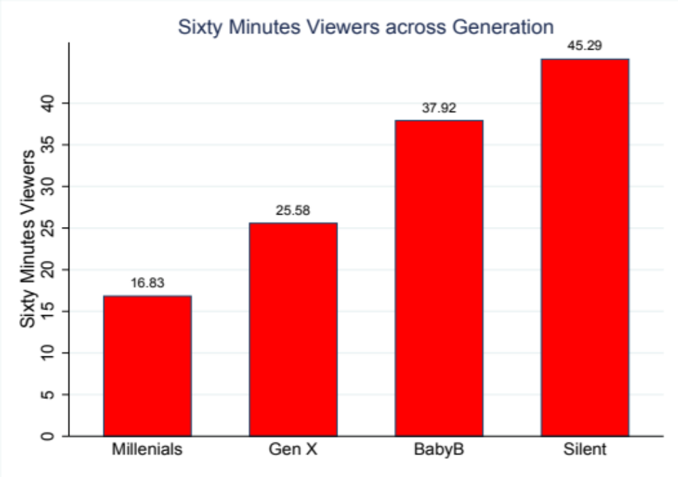
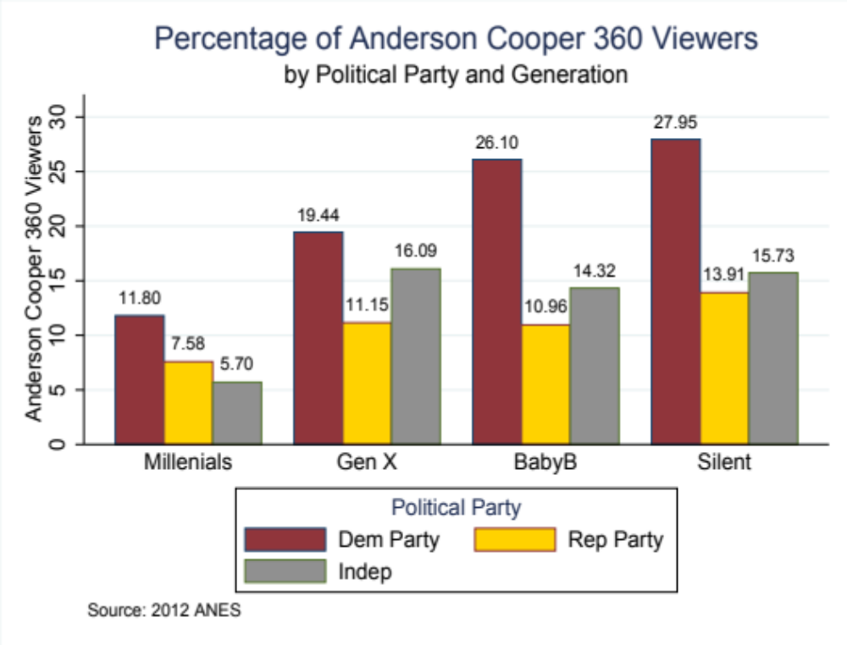
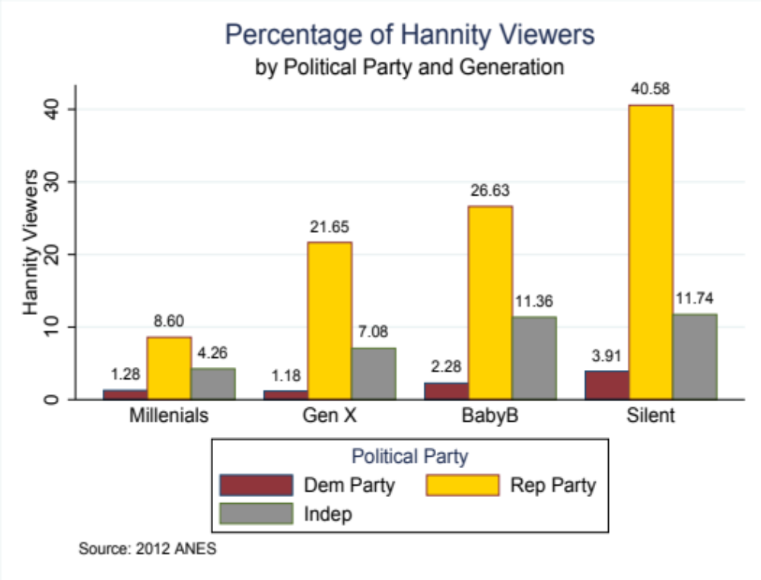
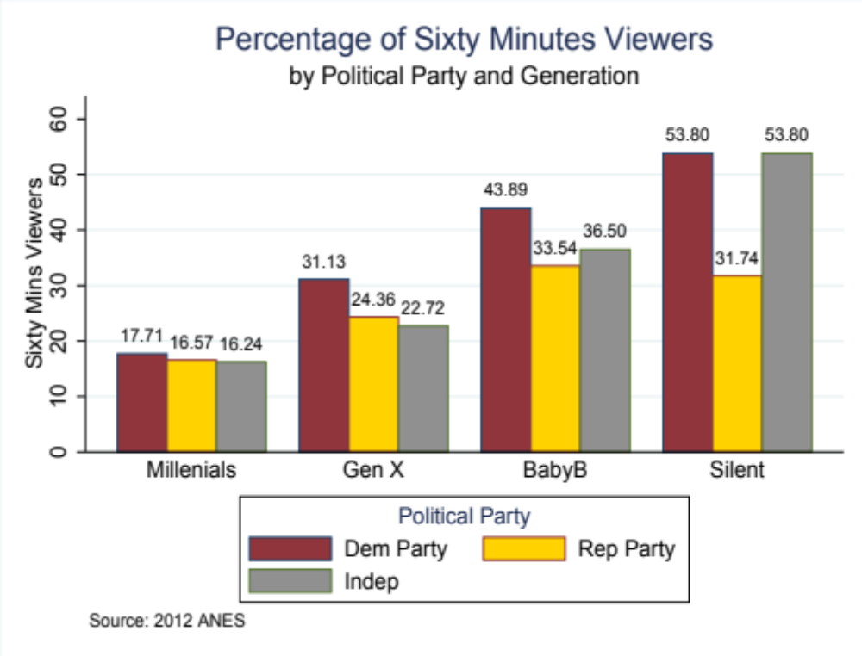
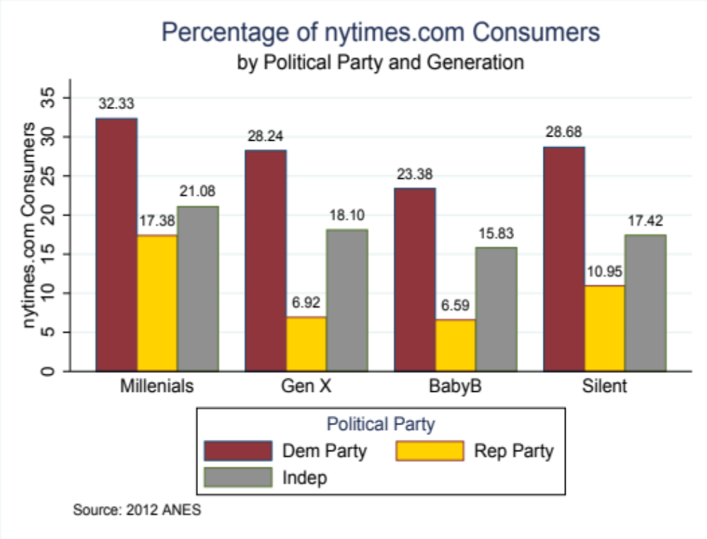
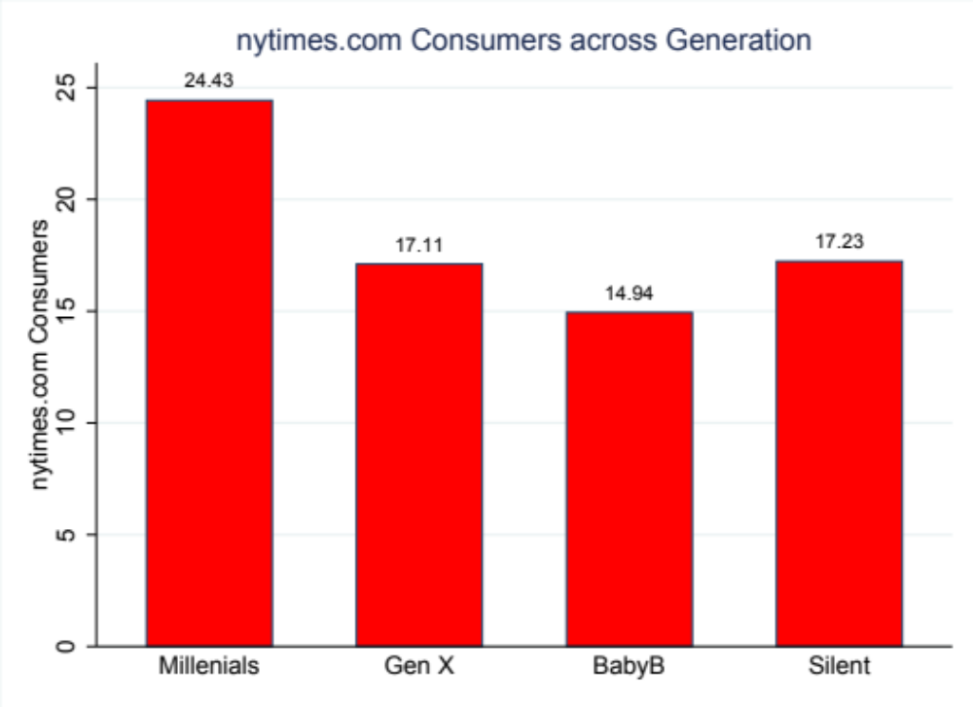
Generational Differences in Media News Consumption
PPA 6010 – Introduction to Policy Research
with Dr. Adriano Udani
Bridgette Edghill, MPPA Graduate Student
University of Missouri – St Louis
In the Era of Fake News
The following question arises: is there a generational difference in those who consume traditional TV news media compared to web-based news media?
Control Variable
Hypotheses 1 and 2 receive support from the data. While the data has more mixed results on news consumption on the web. The questions then becomes do the results stand when controlling for something such as political party? Clearly, as shown below, political affiliation does affect the results. Though, the results were more mixed for Sixty Minutes and CNN.com.
Independent and Dependent Variables
A review of media news consumption across generations involves looking at multiple dependent variables. The following TV news programs and websites were chosen to act as the dependent variable:
Sixty Minutes
Nightly News with Lester Holt
Hannity
Anderson Cooper 360
cnn.com
nytimes.com
These were compared against generation which served as the independent variable. These were broken down into the following categories:
Millennial (aged 18 to 37)
Generation X (aged 38 to 53)
Baby Boomer (aged 54 to 72)
Silent (aged 72 to 90)
Graph 1. Source: ANES 2012
Hypotheses
H₁: In a comparison of individuals, those who are part of the Silent, Baby Boomer generations will be more likely to watch traditional news media broadcasts 60 Minutes, Nightly News than those who are Generation X, Millennials.
H₂: In a comparison of individuals, those who are a part of the Silent generation will be more likely to watch cable-based media (Hannity, Anderson Cooper 360) than those who are Millennials.
H₃: In a comparison of individuals, those who are a part of the Millennial, Gen X generations will be more likely to use web-based media (cnn.com and nytimes.com) than those who are Baby Boomers, Silent generation.
Key
Frequency Percentage
Consumership of Dependent Variables Across Generations
 | Millennial | Gen X | Baby Boomer | Silent
Sixty Minutes | 194.14 16.83% | 244.31 25.58% | 457.97 37.92% | 145.28 45.29%
Nightly News | 117.60 10.20% | 185.67 19.44% | 326.58 27.04% | 101.71 31.71%
Hannity | 50.98 4.34% | 89.12 9.33% | 156.36 12.95% | 66.31 20.67%
Anderson Cooper | 97.65 8.47% | 147.31 15.43% | 211.19 17.49% | 60.47 18.85%
cnn.com | 224.41 21.53% | 169.50 24.75% | 122.86 17.18% | 23.54 26.05%
nytimes. com | 254.64 24.43% | 117.02 17.11% | 106.87 14.94% | 90.36 17.23%
Graph 3, 4, 5, 6. Source: ANES 2012
Conclusion
Analysis of various TV programs and web-based news sites against generations shows that in a zero-ordered relationship (without controls) there does appear to be less of the younger generations (Millennial, Generation X) watching traditional news media than their more senior counterparts (Baby Boomers, Silent.) But, when controlling for political party, the difference becomes more about the preferred political party than about a generational gap. Controls for other factors, such as race, religion, gender, and so on should be considered for future study.
Acknowledgments
My deepest thanks to Dr. Adriano Udani, my classmates, and Zach Pettit for keeping me sane through the semester to make all of what you see here possible. And my parents for their devotion to Nightly News which inspired this project.
Table 1. Source: ANES 2012
Graph 2. Source: ANES 2012

